Slide 1

Bayesian Uncertainty Quantification of Physical Models in Thermal-Hydraulics System Codes
Damar Wicaksono (Thesis Directors: Prof. A. Pautz & Mr. O. Zerkak)
PhD Defense, EPF Lausanne, 19.01.2018

Slide 2
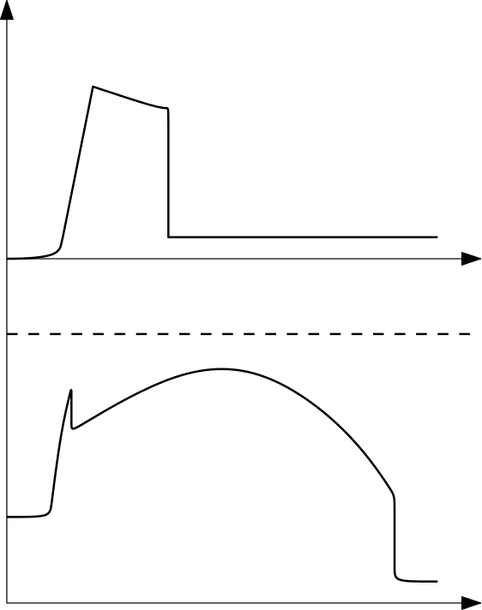
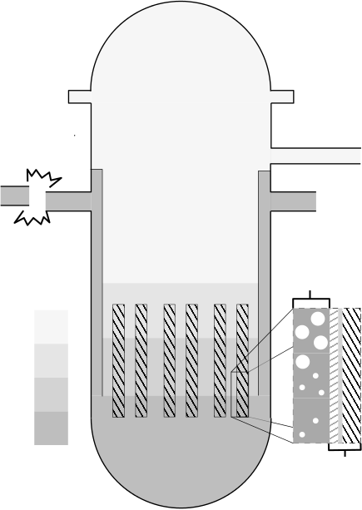
Safety Analysis of LWR under LBLOCA: Show max. clad temperature < safety limit
Reactor Pressure Vessel
ECC Mass Injection
Accumulator
Double-ended
Guillotine Break
Hot Leg
Low Pressure Injection
Cold Leg
Emergency Core Cooling
Clad Temperature
Two-phase
hydraulics
Safety Limit
Reactor Core
Gas Phase
Liquid Phase
Heat conduction through solids
Time
Notes:
Motivation: Safety Analysis of NPP under LBLOCA

Slide 3
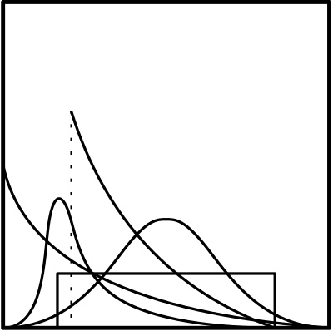
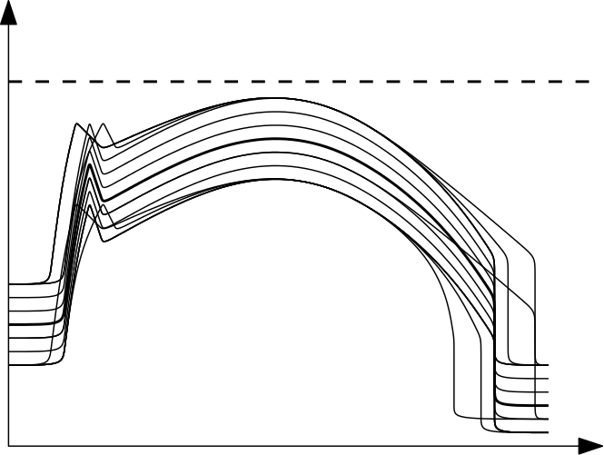
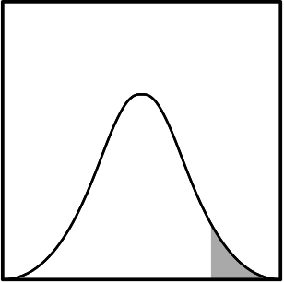

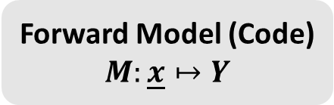
Forward Uncertainty Quantification: Uncertain Inputs $⇒$ Uncertain Outputs
Monte Carlo simulation (multiple code runs)
Forward Model (Code) $$M:\underline{x}↦Y$$
Statistical Analysis of ``Quantities of Interest’’
Uncertain Inputs
(random variables)
Safety Limit
e.g., PCT
Material properties
Initial conditions
Boundary conditions
Physical model parameters
Clad Temperature
Uncertain Outputs
Decision Making
Safe/Fail, Accept/Reject, etc.
Notes:
This is statistical (probabilistic) framework

Slide 4

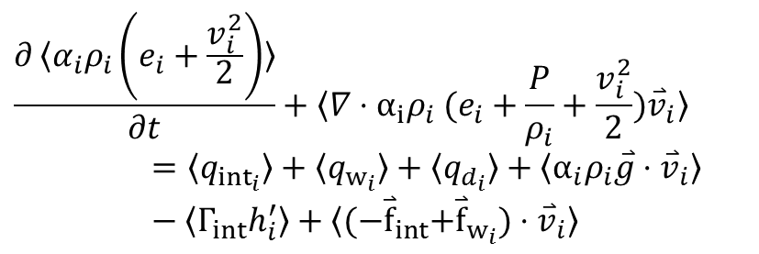
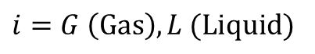
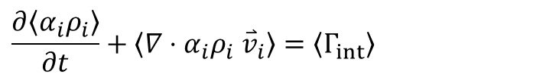
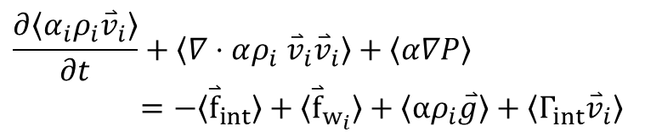
Physical Model Parameters: post-Critical Heat Flux (CHF) Flow Regimes
Mass
Closure Laws
pre-CHF
(Steam Convection)
Parametric
models
$$\frac{∂〈α_{i}ρ_{i}〉}{∂t}+〈∇⋅α_{i}ρ_{i} {\overset{⃑}{v}}_{i}〉=〈Γ_{int}〉$$
Dispersed Flow Film Boiling (DFFB)
Momentum
$$\frac{∂〈α_{i}ρ_{i}{\overset{⃑}{v}}_{i}〉}{∂t}+〈∇⋅αρ_{i} {\overset{⃑}{v}}_{i}{\overset{⃑}{v}}_{i}〉+〈α∇P〉=−〈{\overset{⃑}{f}}_{int}〉+〈{\overset{⃑}{f}}_{w_{i}}〉+〈αρ_{i}\overset{⃑}{g}〉+〈Γ_{int}{\overset{⃑}{v}}_{i}〉$$
Interpolatory (Inverted Slug)
Energy
$$\frac{∂〈α_{i}ρ_{i}\left(e_{i}+\frac{v_{i}^{2}}{2}\right)〉}{∂t}+〈∇⋅α_{i}ρ_{i} (e_{i}+\frac{P}{ρ_{i}}+{\frac{v_{i}^{2}}{2})\overset{⃑}{v}}_{i}〉=〈q_{{int}_{i}}〉+〈q_{w_{i}}〉+〈q_{d_{i}}〉+〈α_{i}ρ_{i}\overset{⃑}{g}⋅{\overset{⃑}{v}}_{i}〉−〈Γ_{int}h_{i}^{′}〉+〈{(−\overset{⃑}{f}}_{int}+{\overset{⃑}{f}}_{w_{i}})⋅{\overset{⃑}{v}}_{i}〉$$
Inverted Annular Film Boiling (IAFB)
Transition Boiling
pre-CHF
(Nucleate Boiling)
$$i=G \left(Gas\right), L (Liquid)$$
Notes:
What are these physical model parameters?
Take for example the phenomenological models that describe two phase flow during a reflood of a dry channel
Closure laws describe the interaction between phases in each distinct **pre-determined** flow regime

Slide 5
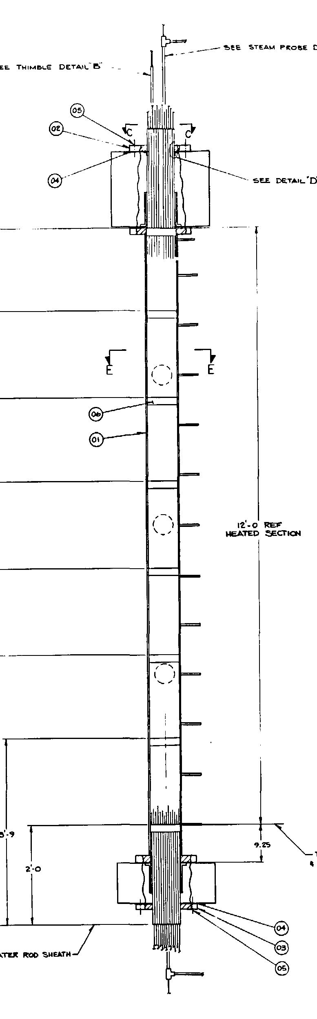
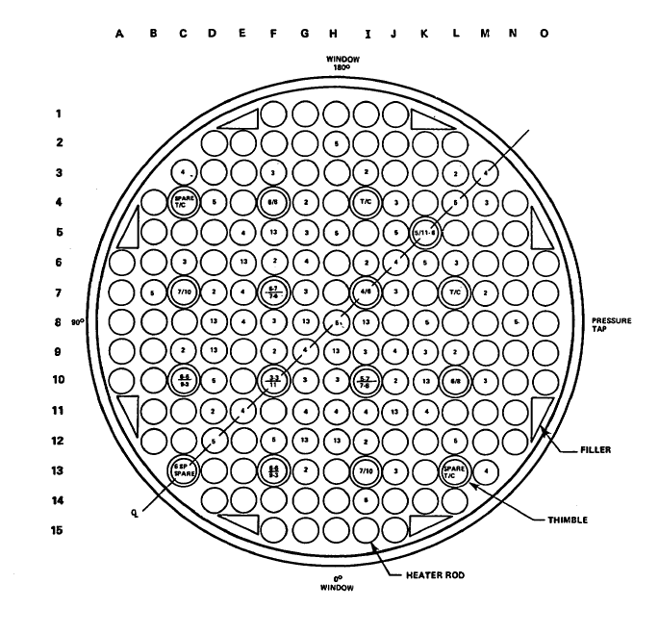
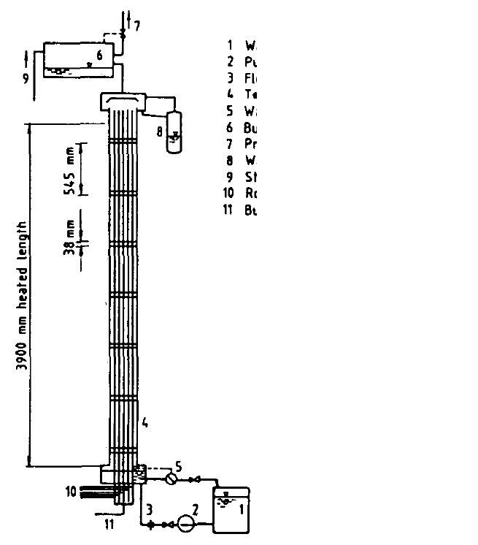
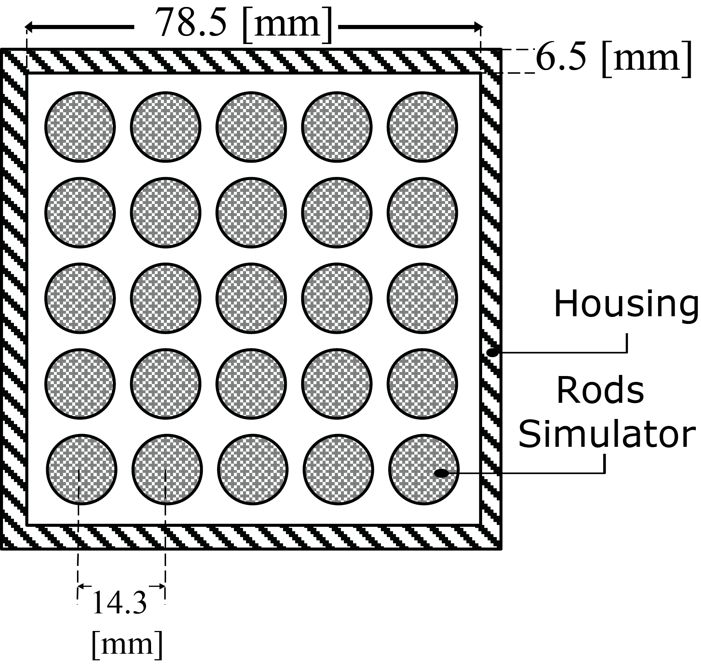
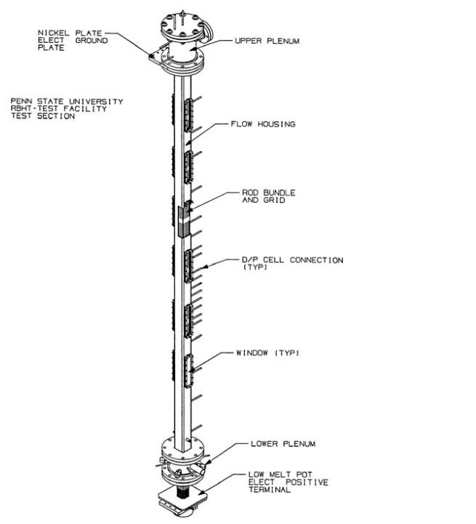
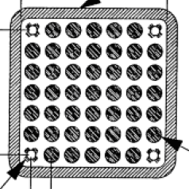
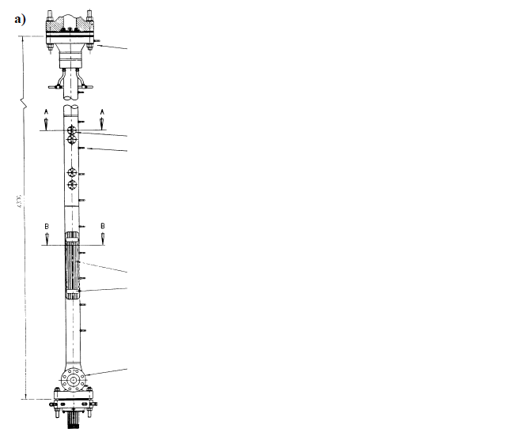
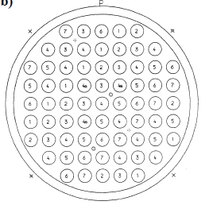
Uncertainty in Physical Model Parameters
Excerpt from the TRACE Code Theory Manual:
“…the approximate value of the coefficient in Eq. (4-119) was determined from data comparisons with FLECHT-SEASET high flooding rate reflood data…” (pp. 164)
“In TRACE, the above interfacial drag coefficient has been reduced by a factor of ¾ to better match FLECHT-SEASET high flooding rate reflood data, so…” (pp. 166)
FLECHT-SEASET
Westinghouse, USA
What if the calibration was done on other, similar, separate effect test facilities (SETFs)?
FEBA
KIT, Germany
RBHT
PSU, USA
ACHILLES
Winfrith, UK
Notes:
Where is this uncertainty coming from

Slide 6
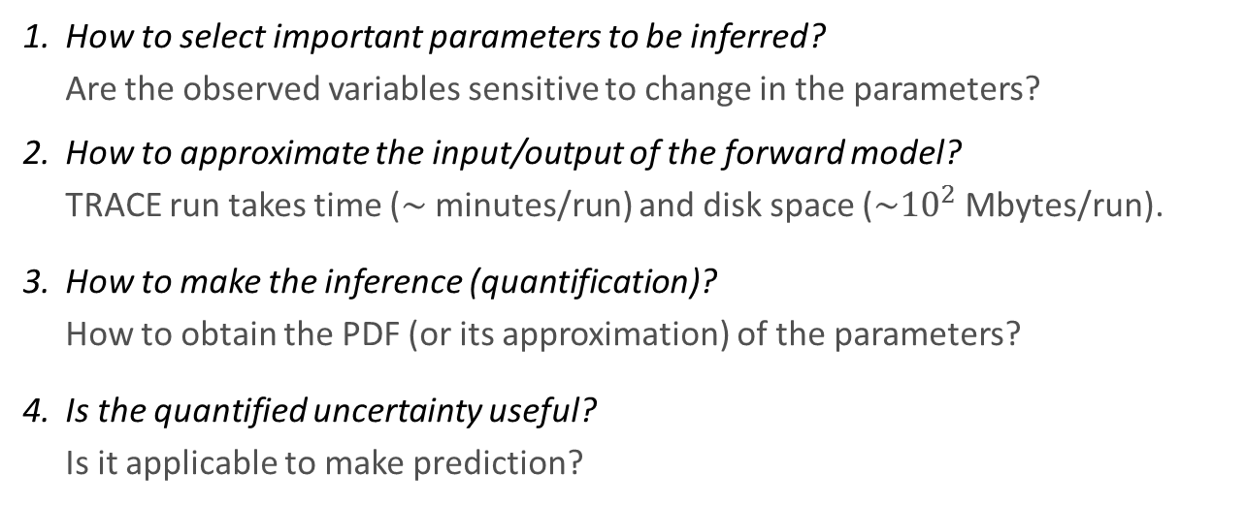
Research Objectives
Given experimental data from a Separate Effect Test Facility (SETF), develop a methodology to:
Quantify the uncertainty of physical model parameters in a TH System Code
to be sampled from and propagated within statistical uncertainty analysis framework.
Cast as a problem of statistical inference and entails four main questions:
How to select important parameters to be inferred? Are the observed variables sensitive to change in the parameters?
How to approximate the input/output of the forward model? TRACE run takes time ($\sim$minutes/run) and disk space ($\sim {10}^{2}$Mbytes/run).
How to make the inference (quantification)? How to obtain the PDF (or its approximation) of the parameters?
Is the quantified uncertainty useful? Is it applicable to make prediction?

Slide 7
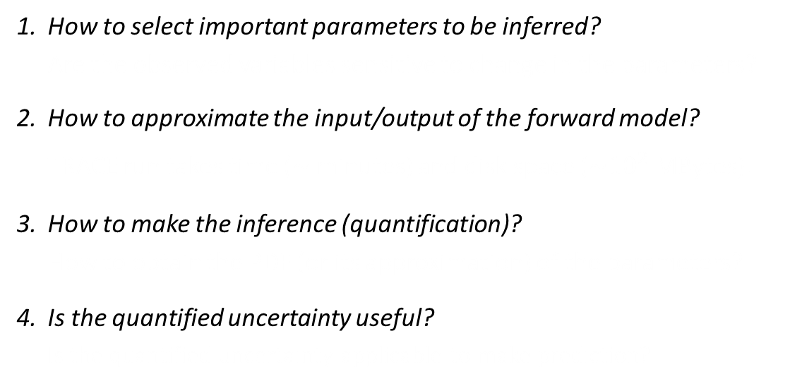
Scope of Research: Statistical Framework
Methods are non-intrusive
Methods require less assumptions about the underlying model
Ultimate results conform with probabilistic framework for UQ
Methods tend to be expensive
(require numerous code runs)
How to select important parameters to be inferred? Are the observed variables sensitive to change in the parameters?
How to approximate the input/output of the forward model? TRACE run takes time ($\sim$minutes) and disk space ($\sim {10}^{2}$MBytes).
How to make the inference (quantification)? How to obtain the PDF (or its approximation) of the parameters?
Is the quantified uncertainty useful? Is the quantified uncertainty applicable to make prediction?
Global Sensitivity Analysis
Gaussian Process Metamodeling
Bayesian Calibration
Uncertainty Propagation
Notes:
To answer those questions, we adapt and implement statistical methodologies derived from applied statistics especially related to the design and analysis of computer experiments.
This will also serve as the outline for the rest of the presentation we will start answering these questions one by one using a running example of TRACE model.
And we don’t develop codes, it is worthwhile to develop methods that is applied outside the code implementation.

Slide 8
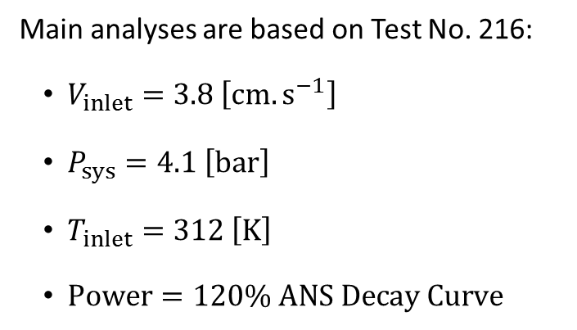
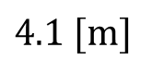
Scope of Research: FEBA Separate Effect Test Facility (SETF)
FEBA Reflood Tests were conducted at Kfz Karlsruhe (KIT) during 1980s for investigating bottom reflood using rod simulators (NiCr)
Main analyses are based on Test No. 216:
$V_{inlet}=3.8 \left[cm.s^{−1}\right]$
$P_{sys}=4.1 \left[bar\right]$
$T_{inlet}=312 \left[K\right]$
$Power=120\% ANS Decay Curve$
$$4.1 [m]$$
Three types of measurements were taken:
Clad temperature (8 axial locations)
Pressure drop (4 axial segments)
Liquid carryover
Notes:
The method is adapted and demonstrated directly to solve this problem.
The problem is used in the OECD/NEA PREMIUM Benchmark

Slide 9
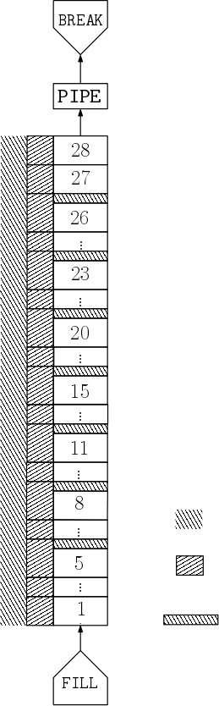
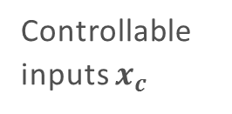
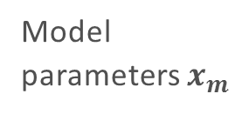
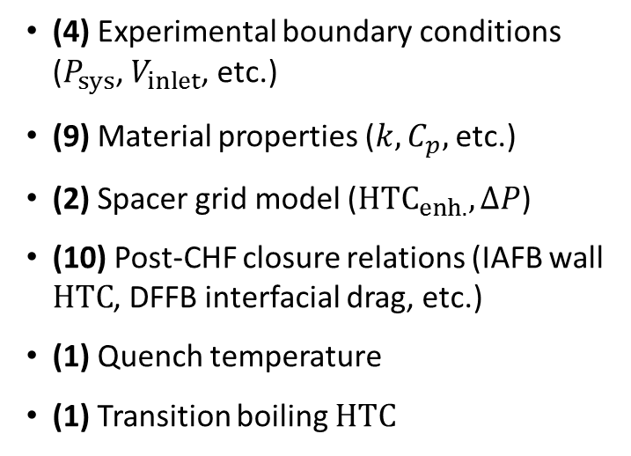
Scope of Research: TRACE Model of FEBA SETF
Backpressure
27 Parameters are required to specify the model:
(4) Experimental boundary conditions ($P_{sys}$, $V_{inlet}$, etc.)
(9) Material properties ($k,C_{p},$etc.)
(2) Spacer grid model ($HTC_{enh.},ΔP$)
(10) Post-CHF closure relations (IAFB wall $HTC$, DFFB interfacial drag, etc.)
(1) Quench temperature
(1) Transition boiling $HTC$
Upper plenum
Controllable inputs $x_{c}$
Model
parameters $x_{m}$
Powered Heater Rods
With flat independent prior uncertainties, either in linear or log scales
Housing/Enclosure
Spacer grid
Inlet flow
Notes:
The method is adapted and demonstrated directly to solve this problem.
The problem is used in the OECD/NEA PREMIUM Benchmark

Slide 10
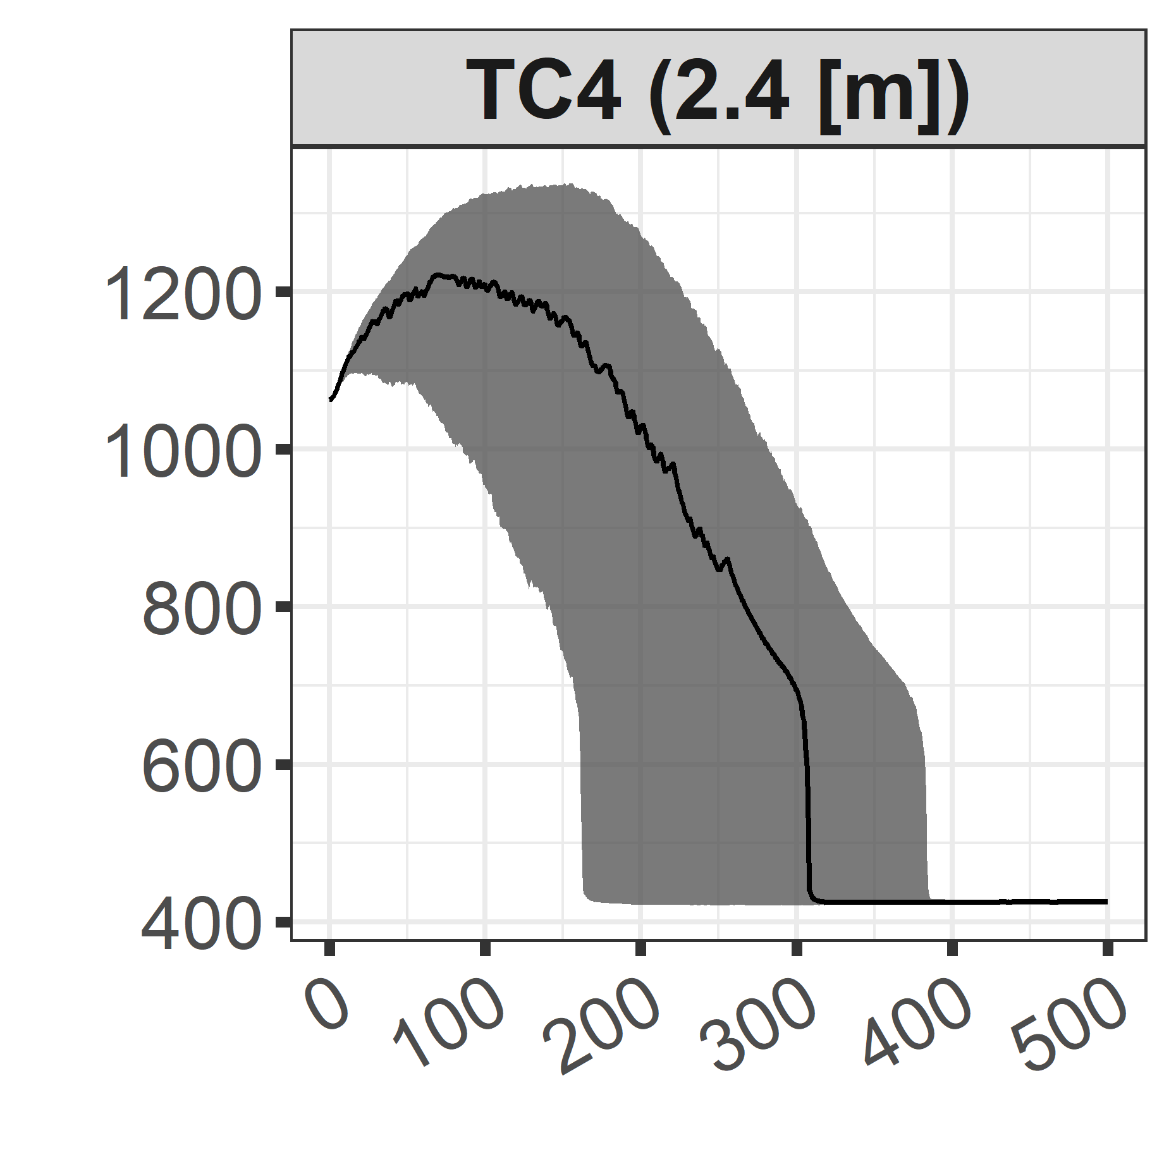
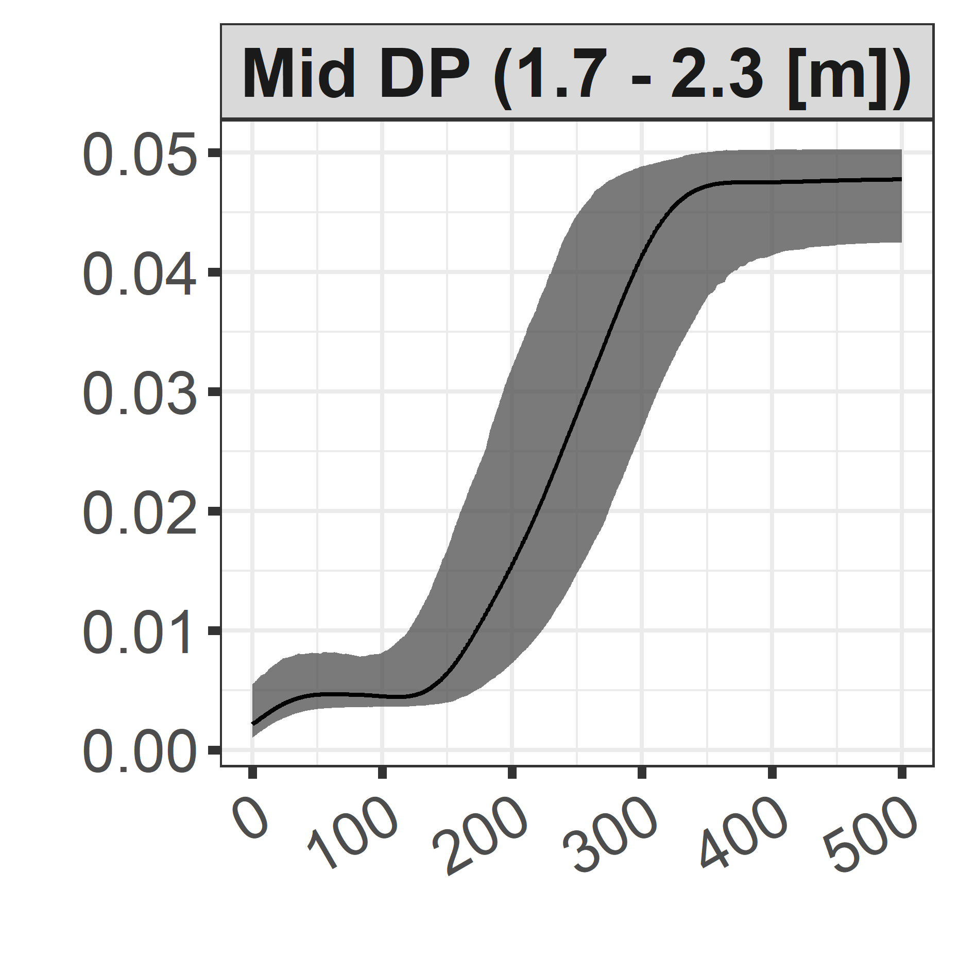
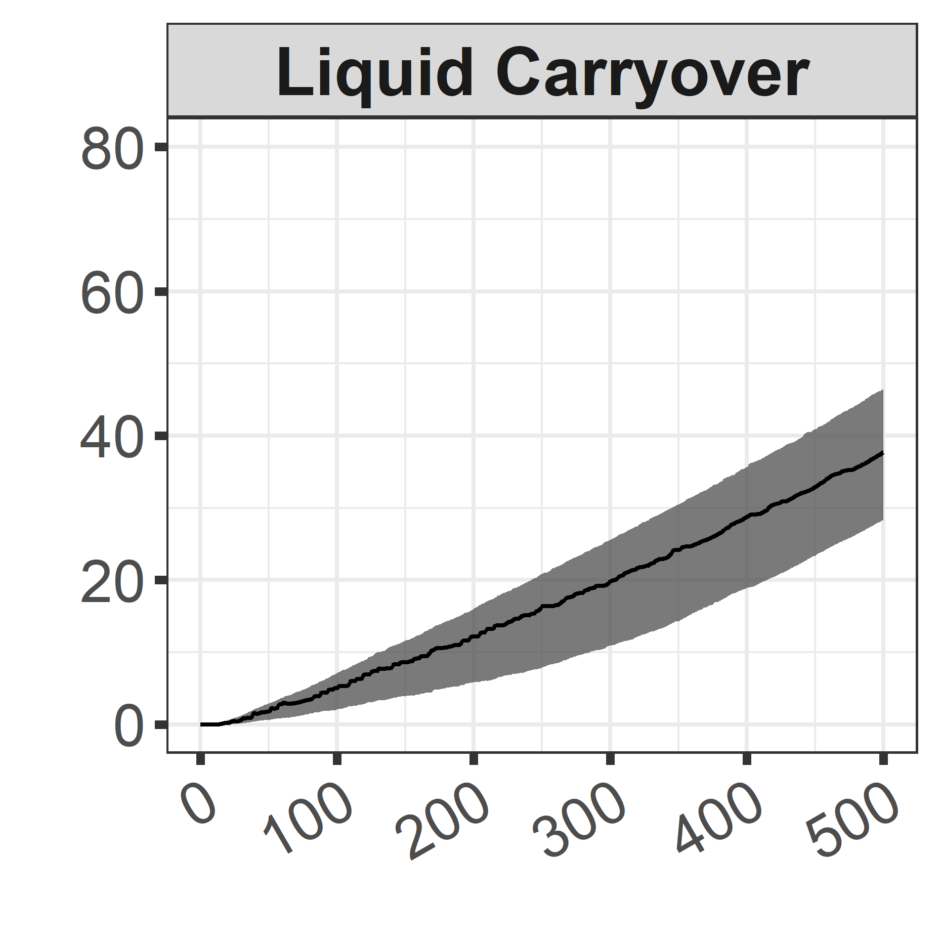
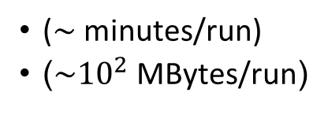
Statistical Framework: Outline
How to select important parameters to be inferred?
Global Sensitivity Analysis
27 initial parameters
Identify the most influential parameters.
For influential parameters, investigate how parameters affect the output and by how much.
How to approximate the input/output of the forward model?
Propagation based on 1’000 samples
Gaussian Process Metamodeling
($\sim$minutes/run)
($\sim {10}^{2}$MBytes/run)
How to make the inference (quantification)?
Clad Temperature [K]
Bayesian Calibration
Pressure Drop [bar]
Liquid Carryover [kg]
Is the quantified uncertainty useful?
Uncertainty Propagation
Time [s]
Notes:
Uncertainty propagation using prior pdfs and 1’000 samples. Bands are constructed based on the 95% probability (2.5th – 97.5th percentile).

Slide 11
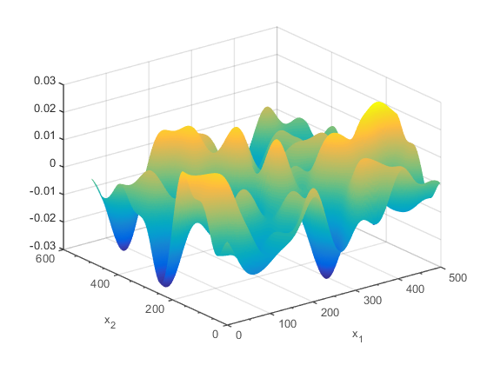
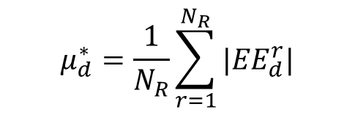
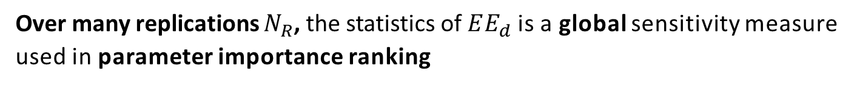
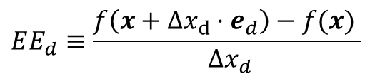
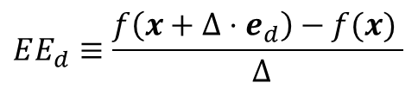
Global Sensitivity Analysis for Screening: The Morris Screening Method
Elementary effect $EE_{d}$ is the effect of a parameter perturbation on the output
$$EE_{d}≡\frac{f\left(x+Δ⋅e_{d}\right)−f(x) }{ Δ}$$
$$EE_{d}≡\frac{f\left(x+Δx_{d}⋅e_{d}\right)−f(x) }{ Δx_{d}}$$
Perturbation of one parameter at a time
Over many replications $N_{R}$, the statistics of $EE_{d}$is a global sensitivity measure used in parameter importance ranking
A complex model
$$μ_{d}^{∗}=\frac{1}{N_{R}}\sum_{r=1}^{N_{R}}{{|EE}_{d}^{r}|}$$
Mean of absolute value

Slide 12
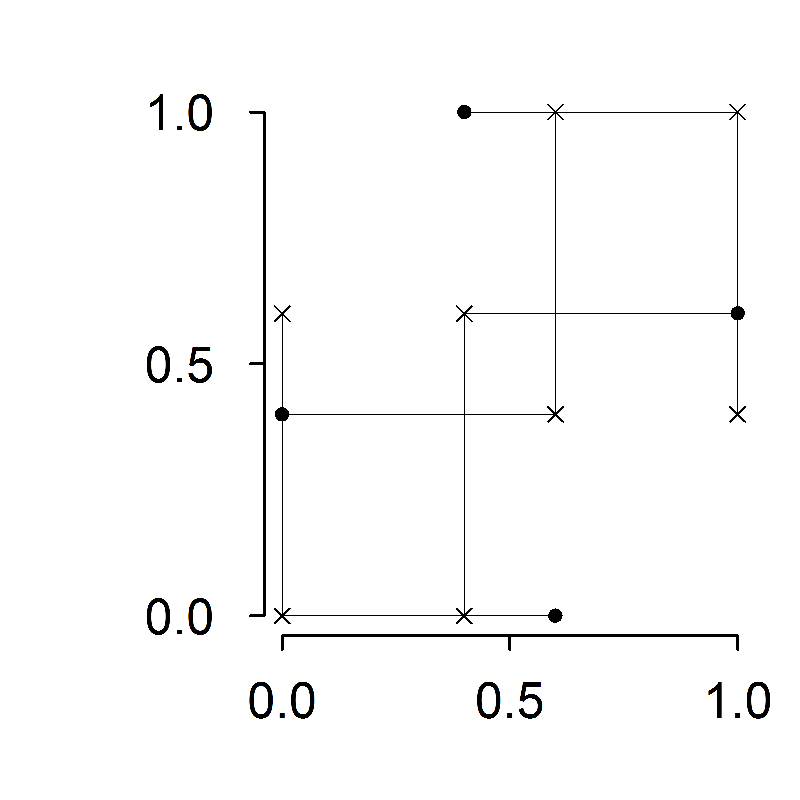
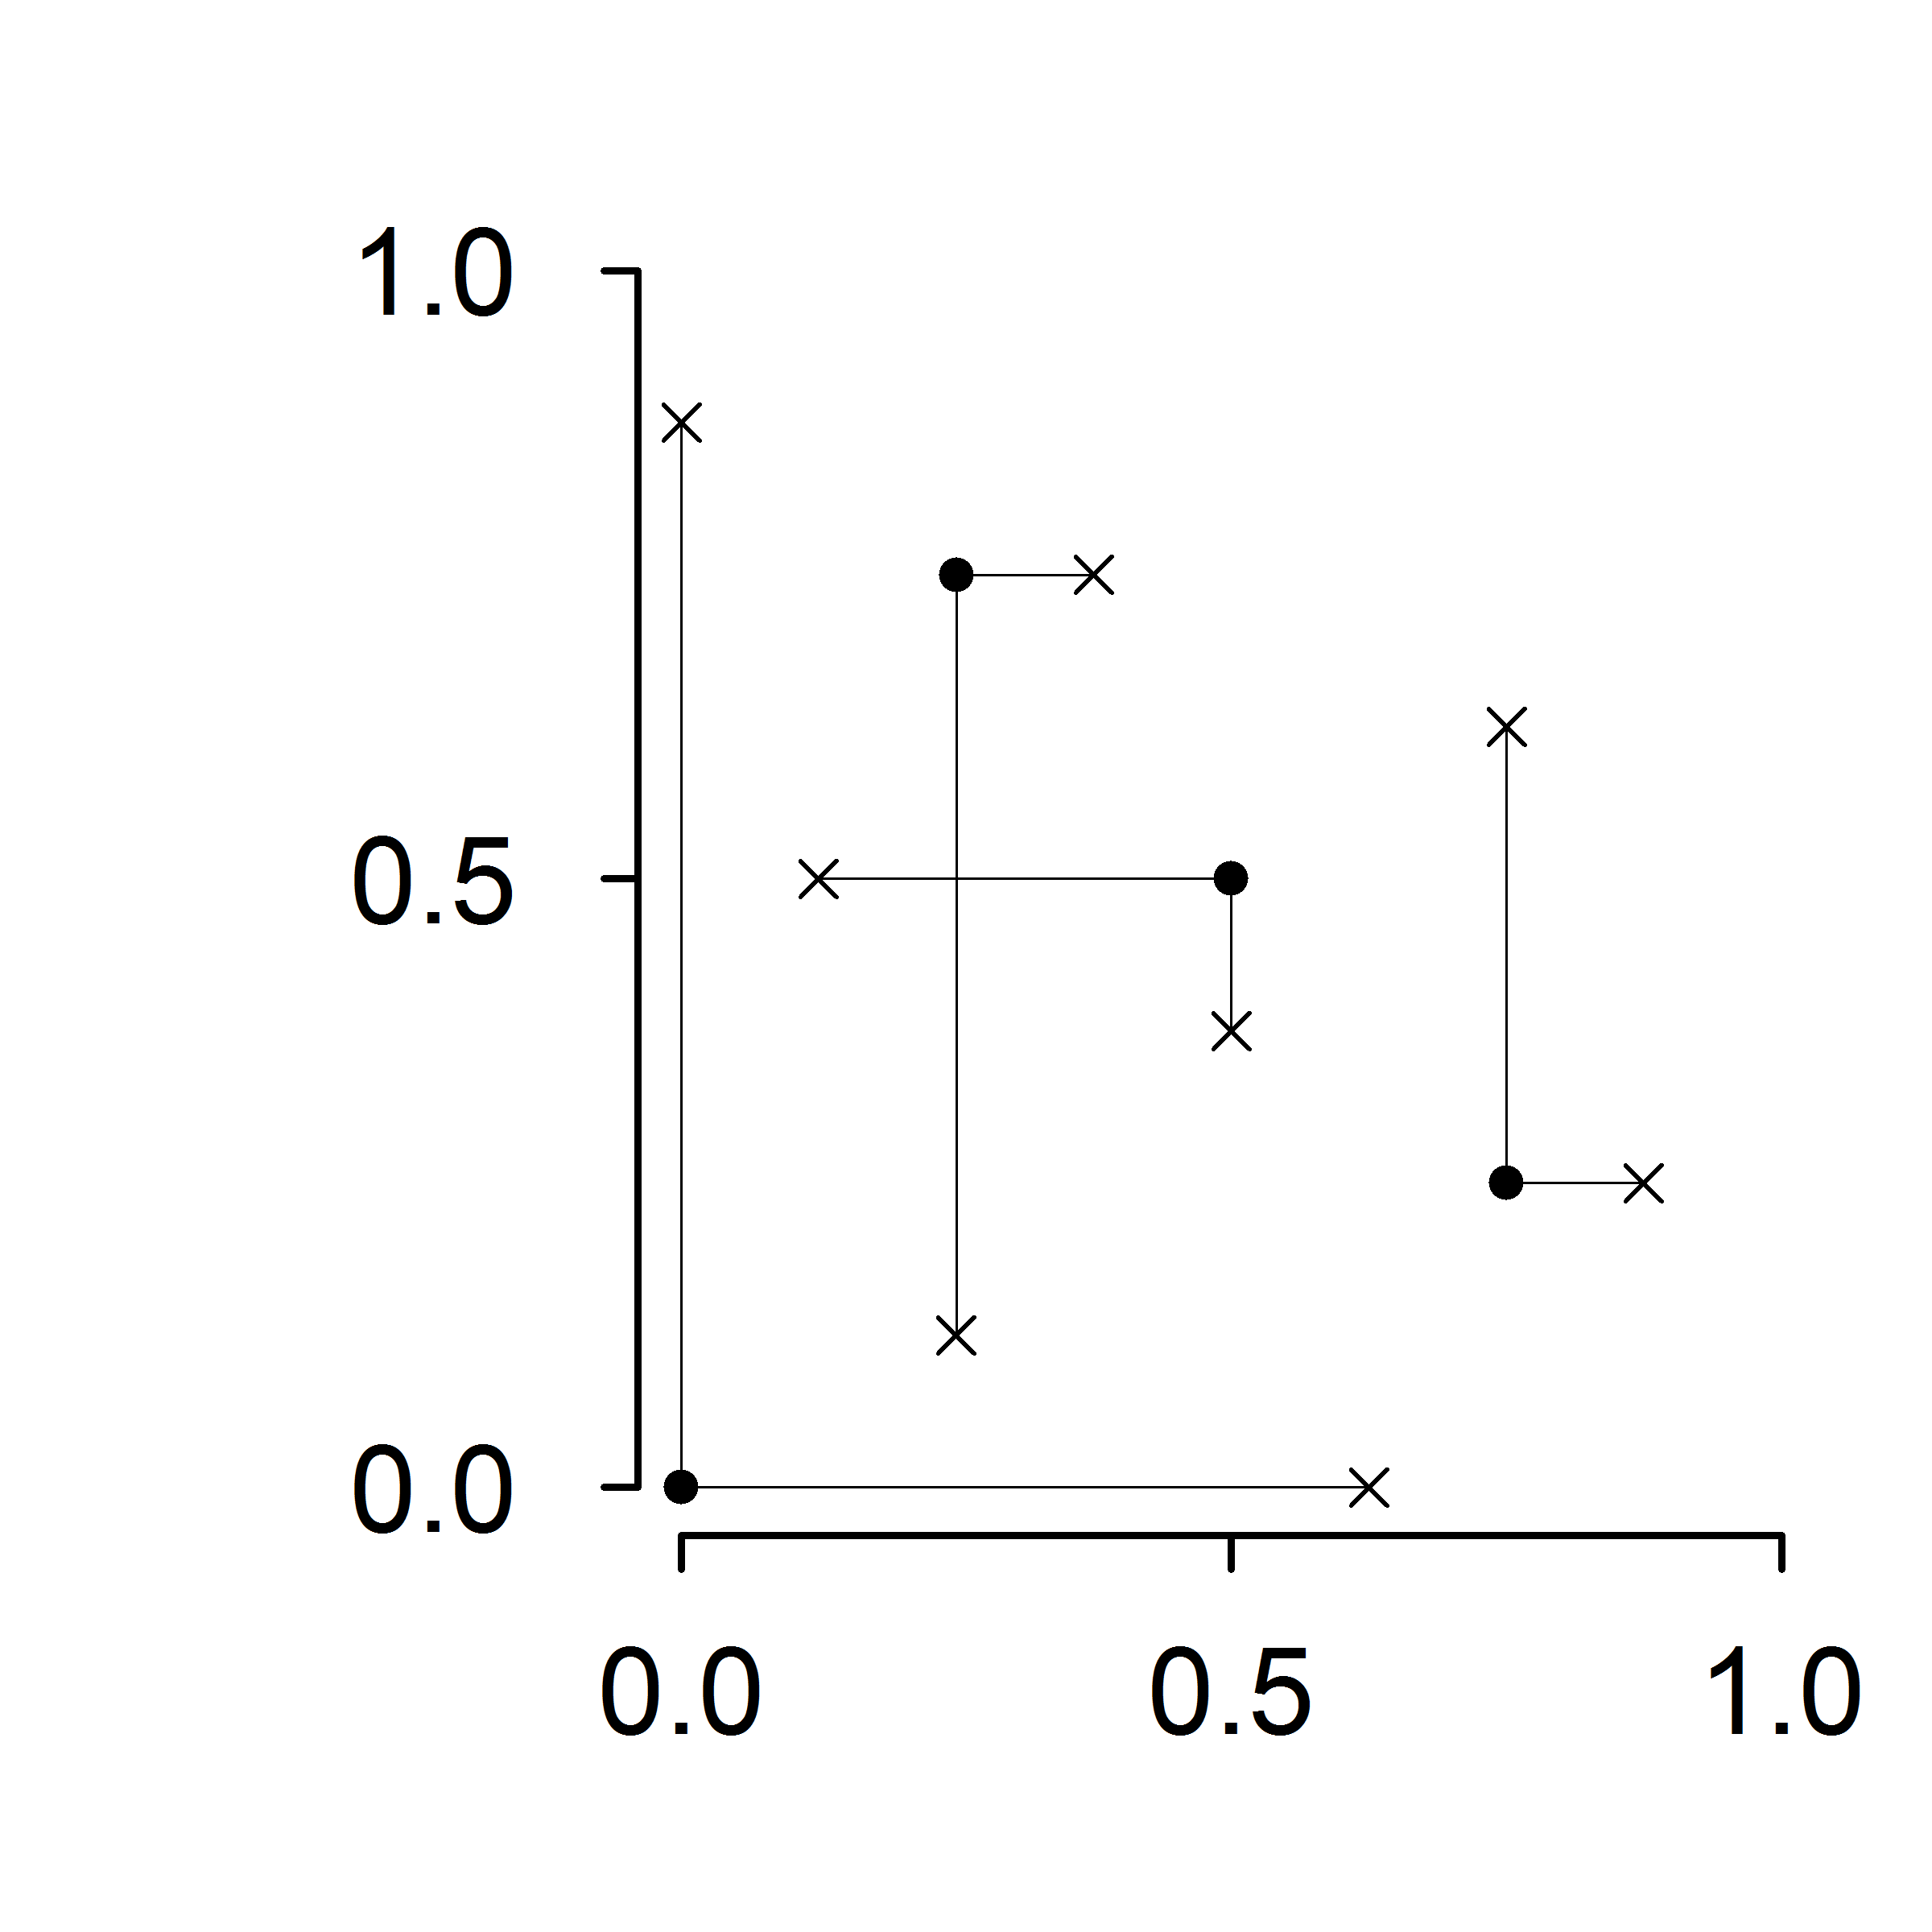



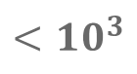


Global Sensitivity Analysis for Screening: The Morris Screening Method
Over many replications $N_{R}$, the statistics of $EE_{d}$is a global sensitivity measure
Trajectory Scheme
Radial Scheme
Illustrations for 2 parameters and 4 replications
$$x_{2}$$
$$x_{2}$$
Base / starting points
Perturbed points
$$x_{1}$$
$$x_{1}$$
Computation cost (Code runs)
$$<{10}^{3}$$
$$N=N_{R}×(D+1)$$
# of parameters
Notes:
The idea of global method is that we don’t use many assumptions regarding the input/output hyper-surface. Perturbation from one point might give different results compared to the perturbation from another point.
We evaluate the input over range that is wide that might cause departure from a well behaved response
But Morris is qualitative (ordinal) does not intuitively tell how important a parameter is.

Slide 13
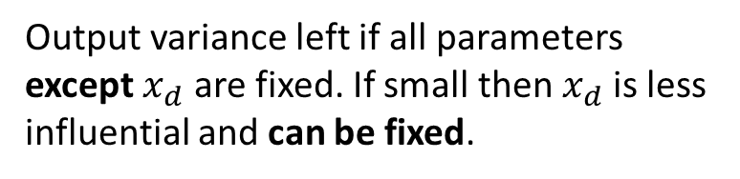
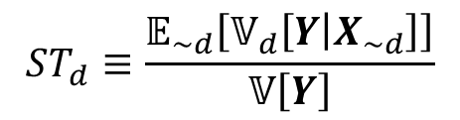
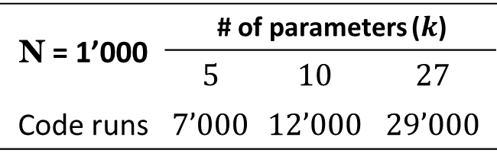
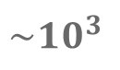

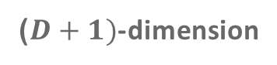
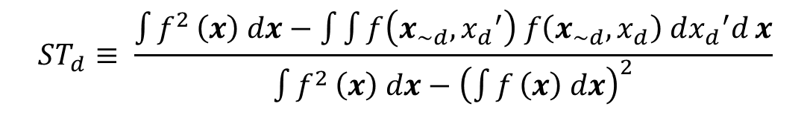
Global Sensitivity Analysis for Screening: Sobol’ Total-Effect Indices
Sobol’ total-effect index for parameter $x_{d}$:
Output variance left if all parameters except $x_{d}$ are fixed. If small then $x_{d}$is less influential and can be fixed.
$$ST_{d}≡\frac{𝔼_{\sim d}\left[𝕍_{d}\left[Y | X_{\sim d}\right]\right]}{𝕍\left[Y\right]}$$
Written in integral form:
($D+1)$-dimension
$$ST_{d}≡ \frac{\int{f^{2}}\left(x\right) dx−\int{\int{f\left(x_{\sim d},{x_{d}}_{}^{′}\right) f\left(x_{\sim d},x_{d}\right) d{x_{d}}_{}^{′}d}}x}{\int{f^{2}}\left(x\right) dx−{\left(\int{f}\left(x\right) dx\right)}^{2}}$$
Computed by Monte Carlo estimation with cost (code runs):
$$\sim {10}^{3}$$
N = 1’000 | # of parameters ($k$)
 | $$5$$ | $$10$$ | $$27$$
Code runs | $$7’000$$ | $$12’000$$ | $$29’000$$
$$N=N_{R}×(D+2)$$
# of parameters

Slide 14
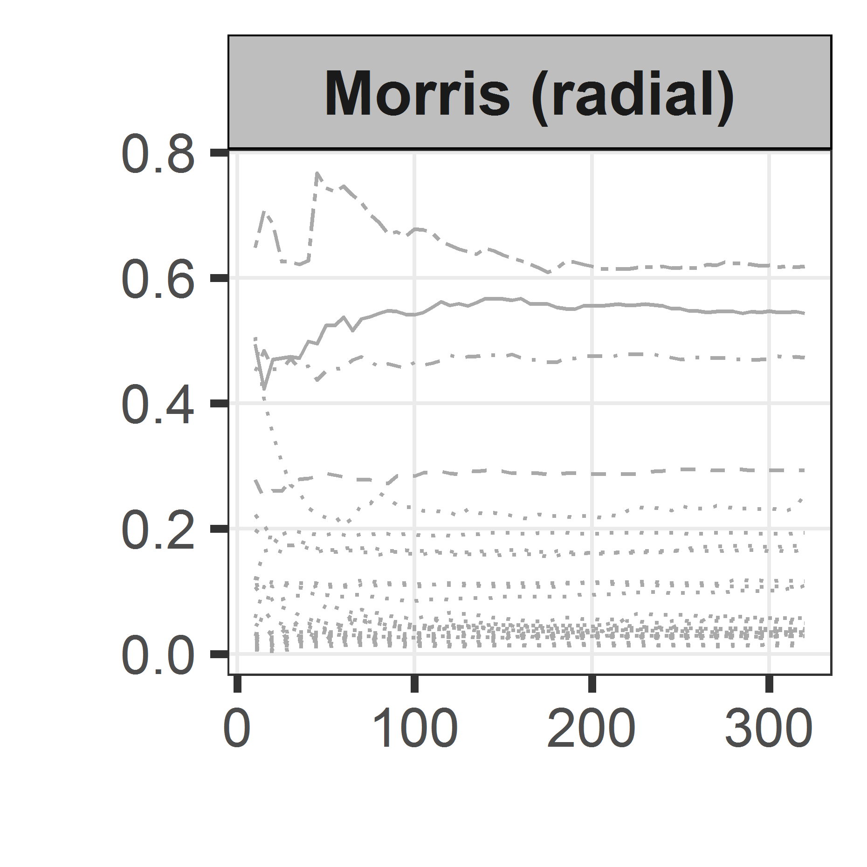
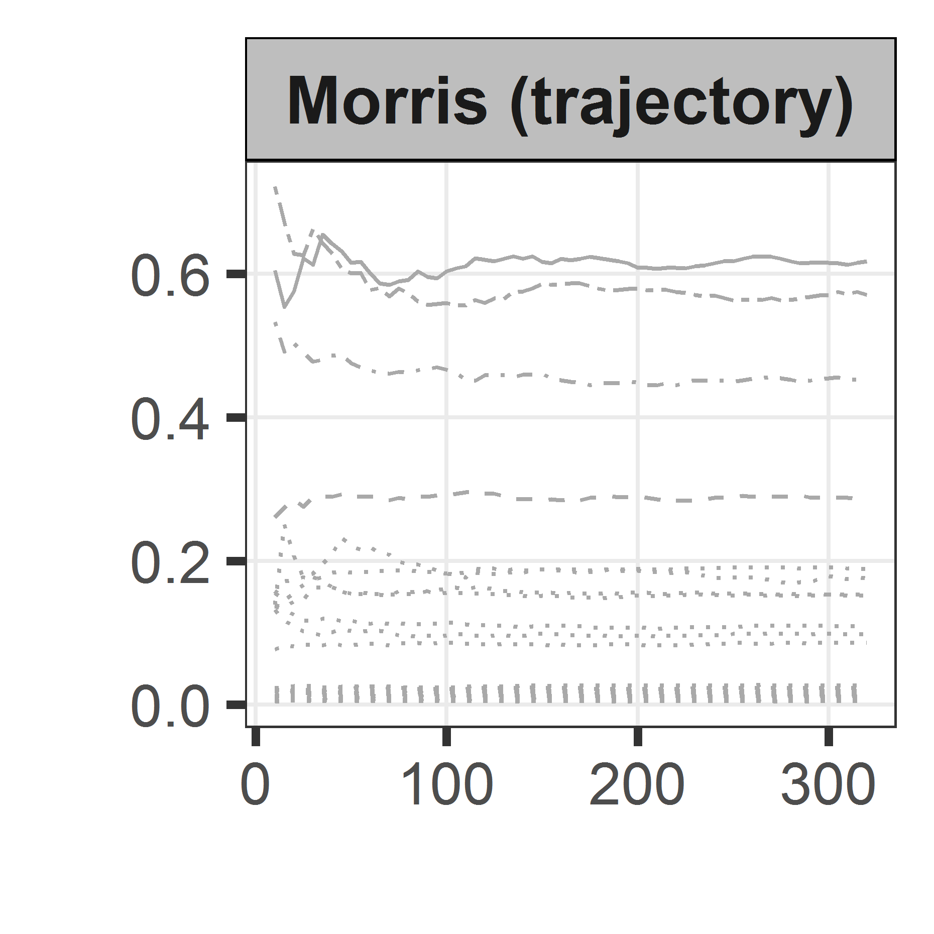
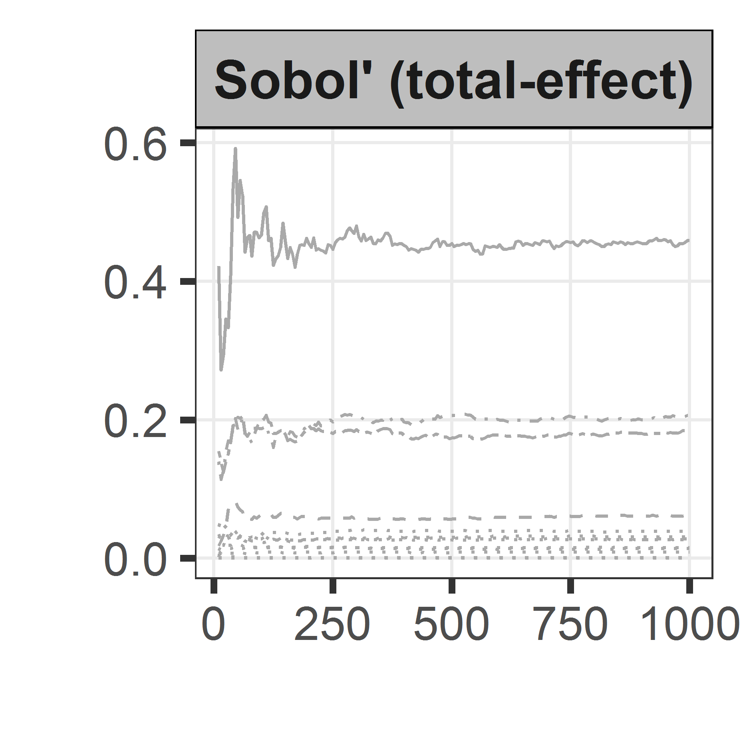
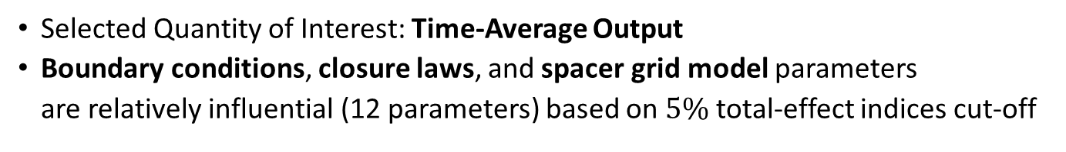
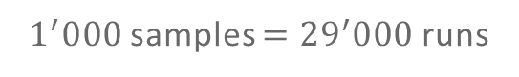

Global Sensitivity Analysis for Screening: Comparison of Methods
Selected Quantity of Interest: Time-Average Output
Boundary conditions, closure laws, and spacer grid model parameters are relatively influential (12 parameters) based on $5\%$ total-effect indices cut-off
$320$ replications $=8^{′}960$runs
$1^{′}000$ samples $={29}^{′}000$runs
Sensitivity Measure
Number of Replications / Samples
Notes:
The three screening methods give (more/less) consistent ranking
Quite a lot of run required but maybe you don’t actually need to run all the way through

Slide 15
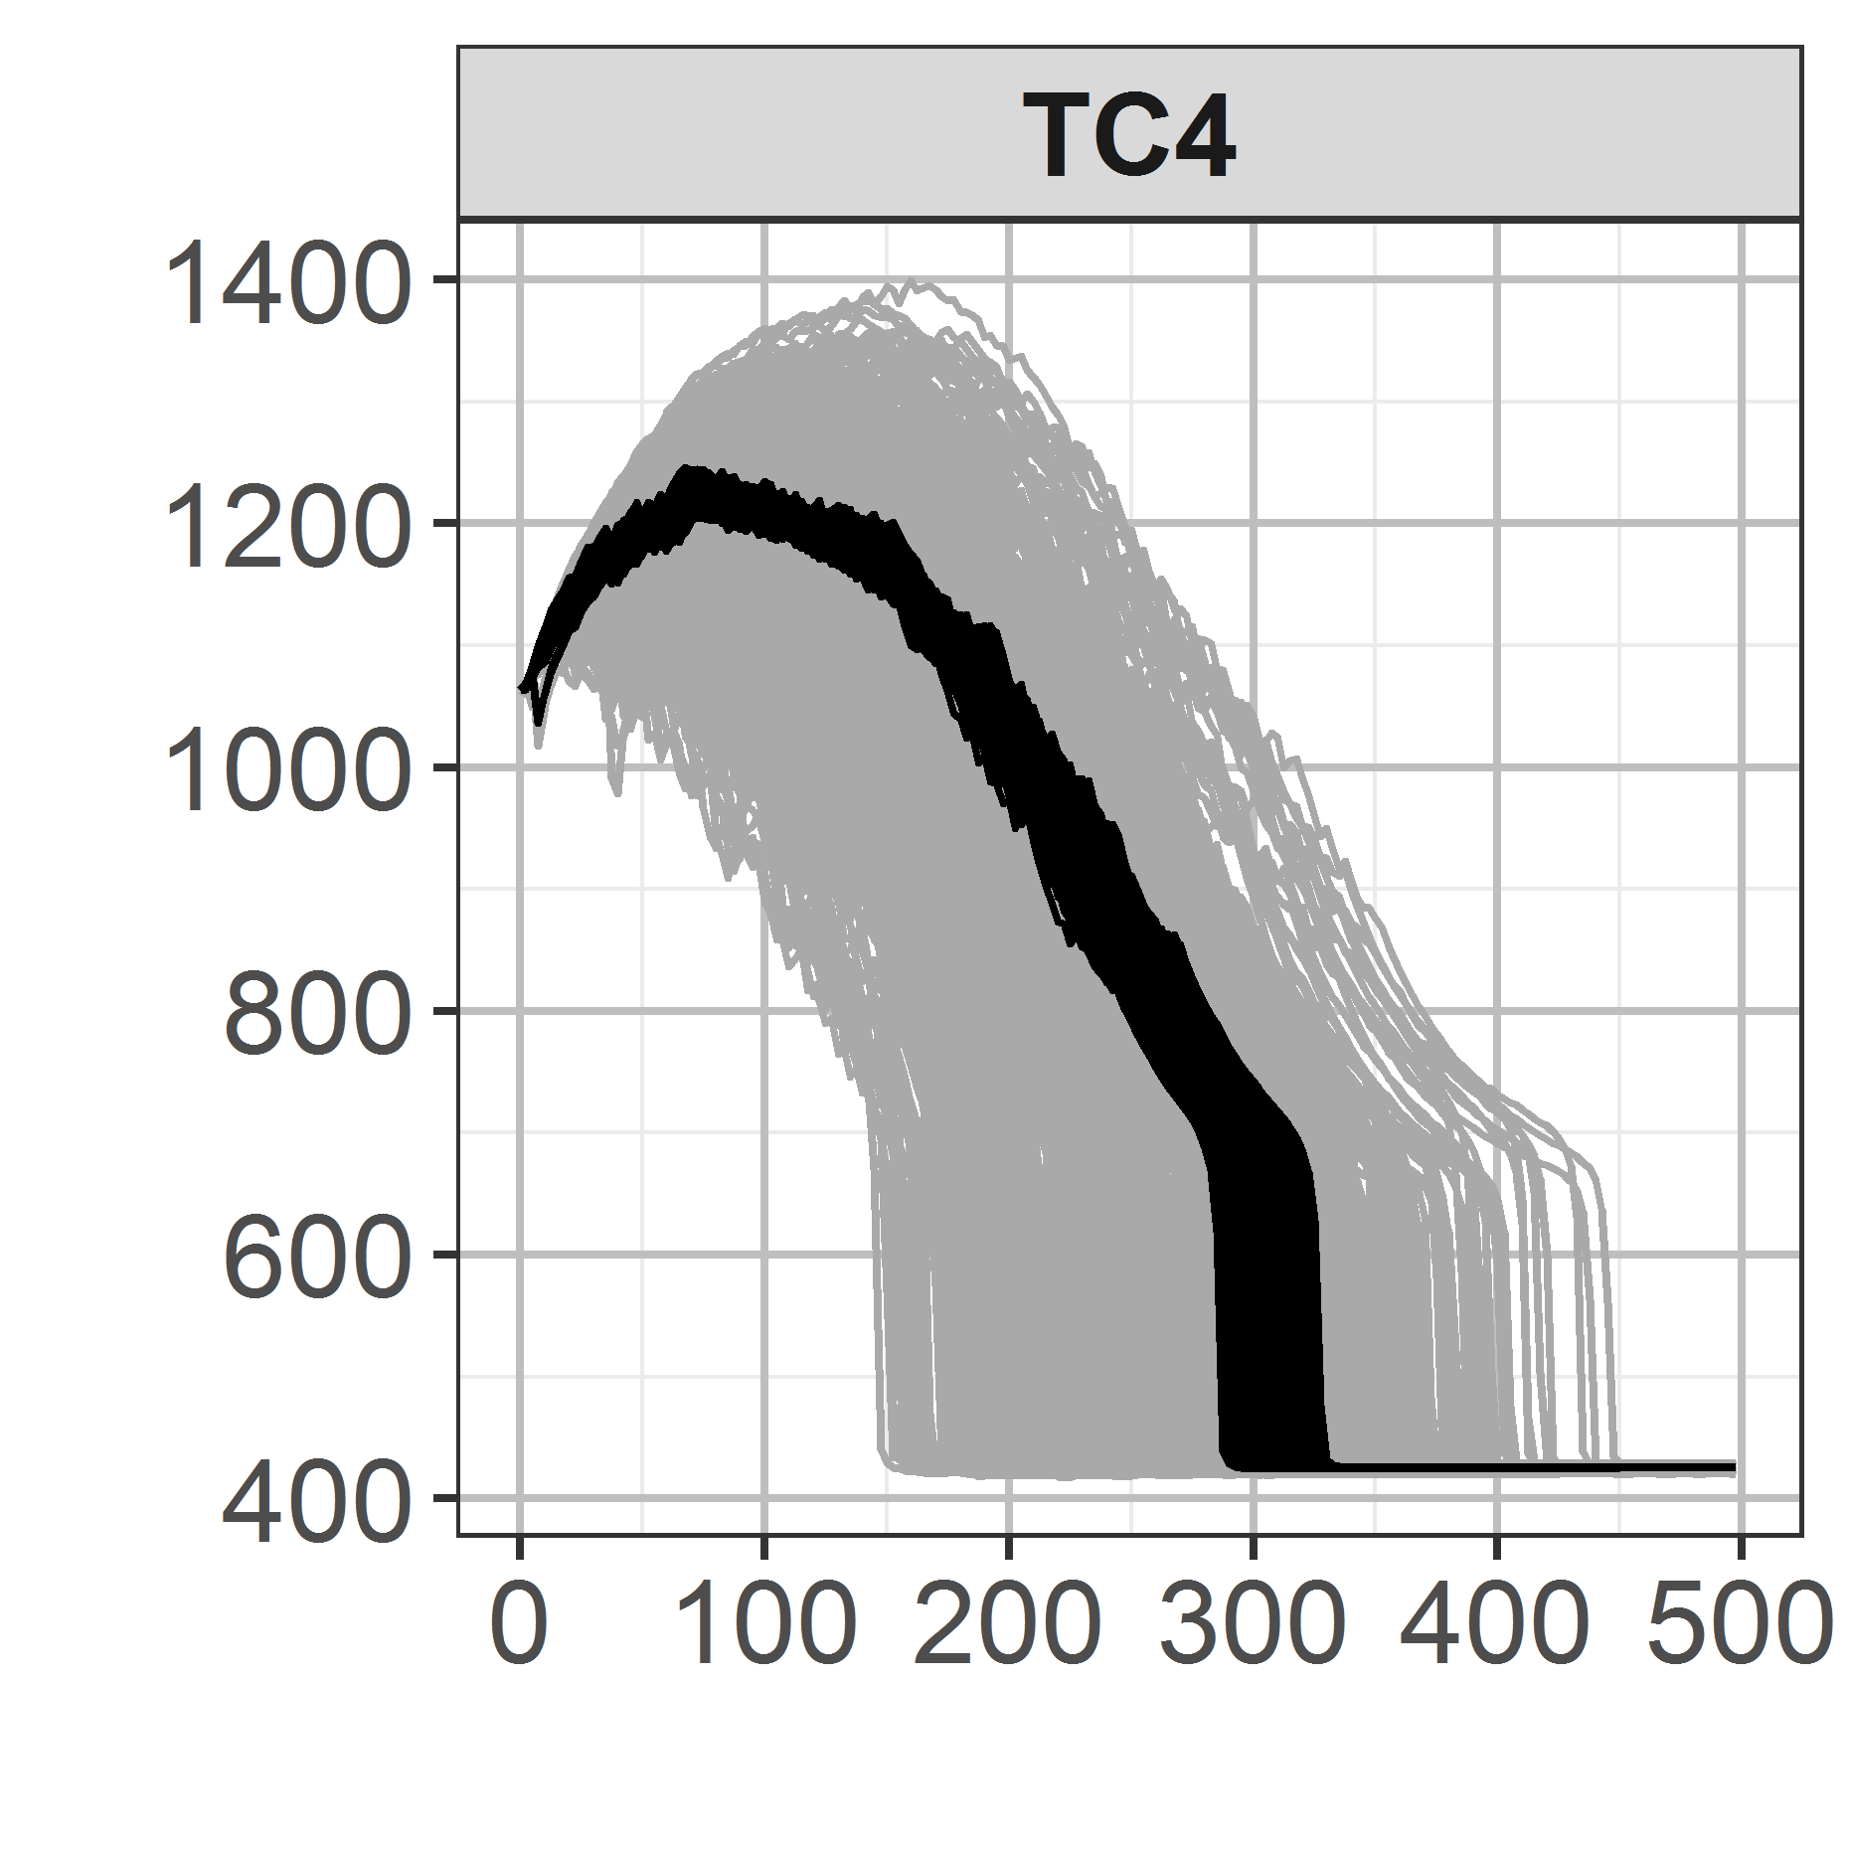


Uncertainty Propagation using Influential vs. Non-Influential Parameters
Uncertainty propagation using 2 parameter subsets and 500 Monte Carlo samples
Clad Temperature [K]
Pressure Drop [bar]
Liquid Carryover [kg]
Time [s]
Parameter subsets
12 Influential
15 Non-influential

Slide 16

Statistical Framework: Outline
How to select important parameters to be inferred?
Global Sensitivity Analysis
27 initial parameters
12 influential parameters
How to approximate the input/output of the forward model?
Gaussian Process Metamodeling
$\sim \left[min\right]/run$
$\sim {10}^{2} \left[MB\right]/run$
Construct a metamodel for fast and efficient approximation
Metamodel = a model of a model

Slide 17









Gaussian Process (GP) Metamodel
Gaussian process is a Gaussian with continuous variates:$Y\left(x\right)∈ℝ;x∈ℝ^{D}$
Gaussian Process
process variance
$$Y(x)\sim GP\left(m(x), σ^{2}k\left(x,x^{∗}\right)\right)$$
e.g., power-exponential correlation, a 2-parameter $\left(α \& η\right)$ function
correlation (kernel) function
Probability distribution of functions
mean function
$$k\left(x,x^{∗}\right)≡Cov\left[Y\left(x\right),Y(x^{∗})\right]=\prod_{d=1}^{D}{\exp\left[−{\left(\frac{{|x}^{\left(d\right)}−x^{∗\left(d\right)}|}{η^{\left(d\right)}}\right)}^{α^{(d)}}\right]}$$
Application in Regression
Prior
Data
Posterior
$$x$$
$$x$$
$$x$$
Notes:
If we fit the hyper-parameters we can use it to make prediction on location of x not observed
As a regression tool it is no

Slide 18




Constructing GP Metamodel: Training and Testing
Different factors involved in the construction of GP Metamodel
Training Runs
Model fitting
$$\hat{f}(x)$$
Different covariance kernels
Validation/Testing Runs
Design of Experiment
Validation/Testing
Different training sample sizes
Different design schemes
Prediction of validation/testing runs

Slide 19





Dealing with Multivariate Output: Principal Component Analysis
Output of the TRACE model of FEBA is highly multivariate.
Output Type | # of outputs $P=Δz×Δt$
Clad Temperature | $$8×{10}^{′}000={80}^{′}000$$
Pressure Drop | $$4×{10}^{′}000={40}^{′}000$$
Liquid Carryover | $$1×{10}^{′}000={10}^{′}000$$
Dimension reduction by Principal Component Analysis (PCA)
SVD
$$Y^{′}=U⋅S⋅V^{T}=W⋅V^{T}$$
Concatenate and centered outputs
Eigenvectors (principal components)
PC scores
$$y^{model}\left(x;z,t\right)={\overline{y}}^{model}\left(z,t\right)+\sum_{i=1}^{Q}{v_{i}\left(z,t\right)⋅w_{i}\left(x\right)}$$
Mean and 1st PC of clad temperature output
Prediction of multivariate output
the mean of output
PC scores as function of input parameters predicted by GP

Slide 20

The training sample size is the main factor for the metamodel performance
Training Sample Size
Major impact
Design of Experiment
Minor impact
Covariance Kernel Functions
Negligible impact

Slide 21














Testing the Trained Metamodel ($N_{train}=1^{′}920$) on the Testing Samples ($N_{test}=5^{′}000$)
Acceptable metamodel predictive performance based on the testing samples
Clad Temperature
Pressure Drop
Liquid Carryover
Predicted Rec. Error [K]
Predicted Rec. Error [Pa]
Predicted Rec. Error [kg]
Observed Rec. Error [K]
Observed Rec. Error [Pa]
Observed Rec. Error [kg]
GP RMSE
$$22.4 [K]$$
$$77.95 [Pa]$$
$$0.27 [kg]$$
Test Data $σ$
$$254. [K]$$
$$9^{′}200 [Pa]$$
$$30.4 [kg]$$
$$(<9\%)$$
$$(<0.9\%)$$
$$(<0.9\%)$$
Notes:
The metamodel prediction is limited by the error due to dimension reduction
It also shows that we cannot go better than the error given by the metamodel.
In context it is find for the time being as the prior uncertainty gives a larger error (standard deviation)

Slide 22

Statistical Framework: Outline
How to select important parameters to be inferred?
Global Sensitivity Analysis
27 initial parameters
12 influential parameters
How to approximate the input/output of the forward model?
Gaussian Process Metamodeling
$\sim \left[min\right]/run$
$\sim {10}^{2} \left[MB\right]/run$
$\sim \left[s\right]/run$
$\sim {10}^{2} \left[MB\right]$
How to make the inference (quantification)?
Bayesian Calibration
Wide, independent prior uncertainties
Use experimental data to constrain the prior

Slide 23








Bayesian Calibration, Inverse Quantification: Uncertain (Inputs + Data) $⇒$Uncertain Inputs Updated
Experimental Data from SETF
$$D$$
Probability of observing data given parameters
Controllable inputs (w.r.t experiment)
$$x_{c}$$
Forward Model $$M:\left(x_{c},x_{m}\right)↦Y$$
Likelihood $$p\left(D|{x_{m},x}_{c} \right)$$
$$X_{m}|D,x_{c}$$
$$X_{m}$$
Uncertain model parameters (prior)
Uncertain model parameters (posterior)
Additional sources of uncertainty
Bayes’
Theorem
$$p\left(x_{m} | D,x_{c}\right)=\frac{p\left(D|x_{m},x_{c}\right)×p\left(x_{m}\right)}{\int_{x_{m}}{p\left(D|x_{m},x_{c}\right)×p\left(x_{m}\right) dx_{m}}}$$

Slide 24
Two Aspects of Bayesian Calibration: Formulation and Computation
Formulation
Computation
Experimental Data from SETF
$$D$$
Controllable inputs (w.r.t experiment)
$$x_{c}$$
Forward Model $$M:\left(x_{c},x_{m}\right)↦Y$$
Likelihood $$p\left(D|{x_{m},x}_{c} \right)$$
$$X_{m}|D,x_{c}$$
$$X_{m}$$
Uncertain model parameters (prior)
Uncertain model parameters (posterior)
Additional sources of uncertainty

Slide 25

Formulation of Bayesian Calibration: True, Measured, and Predicted Values
Experimental data $y^{exp}$is a distorted information of the true value
multi-dimensional data
measurement error,
$$y^{exp}\left(x_{c};z,t\right)=y^{true}\left(x_{c};z,t\right)+ϵ$$
Controlled variables (e.g., pressure, heat flux)
Model prediction is a distorted information of the true value
Computer model
Model bias
Given $y^{exp}\left(x_{c};z,t\right)$, what is the range of consistent $x_{m}$?
$$y^{true}\left(x_{c};z,t\right)=y^{M}\left(x_{c},x_{m};z,t\right)+δ\left(x_{c};z,t\right)$$
Model parameters

Slide 26


Normal Likelihood and Flat Prior: Posterior Formulation
given
GP
GP
Gaussian
Consider only data from one FEBA Test. No $x_{c}$ in formulation.
$$y^{exp}\left(z,t\right)=y^{M}\left(x_{m};z,t\right)+δ\left(z,t\right)+ε$$
unknown
Likelihood
Multiple sources of variance
$$p\left(y^{exp}|x_{m}\right)\sim N\left({\tilde{y}}^{M}+m_{b},VΣ_{w}V^{T}+{V_{>P_{tr}}S}_{>P_{tr}}V_{>P_{tr}}^{T}+Σ_{b}+σ_{exp}^{2}I\right)$$
GP metamodel
Principal Comp. truncation
Model bias
measurement
No | Calibration Schemes
1 | With $δ,$all types of data
2 | $\text{With} δ,$against clad temperature (TC) data only
3 | $\text{With} δ\text{, }$against pressure drop (DP) data only
4 | $\text{With} δ,$against liquid carryover (CO) data only
5 | Without $δ,$ against all type of data
6 | $\text{With} δ,$excluding parameter $dffbVIHT$
6 calibration schemes were investigated

Slide 27






Computation of Bayesian Calibration
Uncertainty on $x_{m}$is fully specified by $p\left(x_{m} | \left\{y_{}^{exp}\right\}\right)$, a multi-dimensional probability density function.
Bayes’ Theorem
Posterior
Likelihood
Prior
$$p\left(x_{m} | \left\{y_{}^{exp}\right\}\right)=\frac{p\left(\left\{y^{exp}\}\right|x_{m}\right)×p\left(x_{m}\right)}{\int_{x_{m}}{p\left(\left\{y^{exp}\}\right|x_{m}\right)×p\left(x_{m}\right) dx_{m}}}$$
How to characterize$x_{m}$? Use sampling.
The Metropolis-Hastings (MH) Algorithm to sample from an un-normalized density $p^{∗}\left(x_{m} | \left\{y_{}^{exp}\right\}\right)$:
Start at a random value of $x_{m}$
Generate sample close to the current value
Accept or reject based on: $α=p^{∗}(x_{m}^{new}|\left\{y_{}^{exp}\right\})/p^{∗}\left(x_{m}^{old}|\left\{y_{}^{exp}\right\}\right)$
Notes:
MH in a nutshell

Slide 28


















Constraining the Prior Uncertainty Range of the Model Parameters
gridHT
The prior uncertainty of the model parameters
iafbWHT
dffbWHT
Calibration simulation setup:
Ensemble MCMC
$2×10^{6}$samples generated
Converge after $\frac{2}{5}$ of the way
dffbVIHT
iafbIntDr
dffbIntDr
dffbWDr
tQuench
$$1/2$$
$$2$$
$$1/2$$
$$2$$
$$1/2$$
$$2$$
$$1/4$$
$$4$$
$$1/4$$
$$4$$
$$1/4$$
$$4$$
$$1/2$$
$$2$$
$$−50$$
$$50$$
Notes:
Can the data and the calibration model can be used to constrain this prior?

Slide 29


Visualizing Multi-dimensional Posterior: How to read a corner plot?
gridHT
Projection into one axis
Visualize the uncertainty of a parameter
iafbWHT
dffbWHT
$$p\left(x_{d}\right)=\int{p\left(x\right)dx_{\sim d}}$$
dffbVIHT
Bivariate Marginals
Univariate Marginals
iafbIntDr
Joint plot of two parameters
Visualize pairwise correlations
Lighter color = high concentration of samples
$$p\left(x_{d_{1}},x_{d_{2}}\right)=\int{p\left(x\right)dx_{\sim d_{1,2}}}$$
dffbIntDr
dffbWDr
tQuench
$$1/2$$
$$2$$
$$1/2$$
$$2$$
$$1/2$$
$$2$$
$$1/4$$
$$4$$
$$1/4$$
$$4$$
$$1/4$$
$$4$$
$$1/2$$
$$2$$
$$−50$$
$$50$$
Notes:
Can the data and the calibration model can be used to constrain this prior?

Slide 30
Constraining the Prior Uncertainty Range of the Model Parameters
gridHT
The prior uncertainty of the model parameters
iafbWHT
dffbWHT
Calibration simulation setup:
Ensemble MCMC
$2×10^{6}$samples generated
Converge after $\frac{2}{5}$ of the way
dffbVIHT
iafbIntDr
dffbIntDr
dffbWDr
tQuench
$$1/2$$
$$2$$
$$1/2$$
$$2$$
$$1/2$$
$$2$$
$$1/4$$
$$4$$
$$1/4$$
$$4$$
$$1/4$$
$$4$$
$$1/2$$
$$2$$
$$−50$$
$$50$$
Notes:
Can the data and the calibration model can be used to constrain this prior?

Slide 31


Results: Considering multiple types of data helps constrain the parameters uncertainty
gridHT
The posterior based on pressure drop data only
($≈10^{6}$samples)
iafbWHT
dffbWHT
dffbVIHT
iafbIntDr
dffbIntDr
dffbWDr
tQuench
$$1/2$$
$$2$$
$$1/2$$
$$2$$
$$1/2$$
$$2$$
$$1/4$$
$$4$$
$$1/4$$
$$4$$
$$1/4$$
$$4$$
$$1/2$$
$$2$$
$$−50$$
$$50$$
Notes:
The vertical lines in the diagonal is the 95% credible interval

Slide 32


Results: Considering multiple types of data helps constrain the parameters uncertainty
gridHT
The posterior based on all types of data
($≈10^{6}$samples)
iafbWHT
dffbWHT
dffbVIHT
iafbIntDr
dffbIntDr
dffbWDr
tQuench
$$1/2$$
$$2$$
$$1/2$$
$$2$$
$$1/2$$
$$2$$
$$1/4$$
$$4$$
$$1/4$$
$$4$$
$$1/4$$
$$4$$
$$1/2$$
$$2$$
$$−50$$
$$50$$
Notes:
Data can help constrain the prior range of the model parameters. (only small part of the prior that is consistent with the calibration data)
But the posterior samples also exhibit correlation among the parameters

Slide 33

Results: Posterior Samples are Correlated (i.e., a set of “collectively-fitted” values)
Uncertainty propagation on FEBA Test. No. 216 (the calibration data) based on 1’000 Monte Carlo samples.
Middle assembly
Top assembly
Clad Temperature [K]
Time [s]
Prior
Posterior, Independent
Posterior, Correlated
Notes:
A set of “collectively-fitted” values which means that if we don’t consider them as a collection then the prediction would less match the calibration data itself.
If we only consider the univariate marginals (neglecting correlation) we obtain prediction that is less consistent with the calibration data.
Only if we consider the posterior samples jointly, that the prediction match the experimental data better.

Slide 34

Results: Posterior without Model Bias Term Some nominal parameters are outside 95% CIs*
gridHT
Calibration using all types of data, w/o Model Bias Term
iafbWHT
dffbWHT
dffbVHT
iafbIntDr
*Credible intervals
dffbIntDr
dffbWDr
tQuench
$$1/2$$
$$2$$
$$1/2$$
$$2$$
$$1/2$$
$$2$$
$$1/4$$
$$4$$
$$1/4$$
$$4$$
$$1/4$$
$$4$$
$$1/2$$
$$2$$
$$−50$$
$$50$$

Slide 35
Statistical Framework: Outline
How to select important parameters to be inferred?
Global Sensitivity Analysis
27 initial parameters
12 influential parameters
How to approximate the input/output of the forward model?
Gaussian Process Metamodeling
$\sim \left[min\right]/run$
$\sim {10}^{2} \left[MB\right]/run$
$\sim \left[s\right]/run$
$\sim {10}^{2} \left[MB\right]$
How to make the inference (quantification)?
Bayesian Calibration
Wide, independent prior uncertainties
Narrower, correlated posterior uncertainties
Is the quantified uncertainty useful?
Wide prior prediction uncertainties
Propagate posterior uncertainties for different experimental conditions
Uncertainty Propagation

Slide 36







Comparing Different Calibration Results: Informativeness vs. Calibration Score
Two scores to summarize and compare results of uncertainty propagation using different posterior samples w.r.t to the prior
Informativeness for output $y$
$${Inf}_{Y}=1−\frac{1}{2}\frac{UUB_{post.}−LUB_{post.}}{UUB_{prior}−LUB_{prior}}$$
LUB: Lower Uncertainty Bound
($2.5th$ prediction percentile)
UUB: Upper Uncertainty Bound
($97.5th$ prediction percentile)
$${Inf}_{Y}=0.5$$
Posterior prediction uncertainty is equal to that of the prior
$${Inf}_{Y}=1.0$$
No posterior prediction uncertainty
Notes:
Think of a posterior prediction is a source of information for output y and defined only in three values, the lower uncertainty bound, the upper uncertainty bound and the reference value
Informativeness tries to measure the width of posterior uncertainty band relative to that of the prior

Slide 37







Comparing Different Calibration Results: Informativeness vs. Calibration Score
Two scores to summarize and compare results of uncertainty propagation using different posterior samples w.r.t to the prior
Calibration Score for output $y$
$${Cal}_{Y}=π_{Y}\left(y_{exp}\right)$$
The height of the experimental data in the information triangle
$y_{ref}$: Reference value
($50th$ prediction percentile; median)
$${Cal}_{Y}=0.0$$
Experimental data falls outside the uncertainty band
$${Cal}_{Y}=1.0$$
Experimental data matches the reference value exactly
Notes:
Calibration measure the location of experimental data inside the so called “information” triangle

Slide 38







Posterior Uncertainties are More Informative but can be Much Less “calibrated”
${=P}_{sys}$, $↑V_{inlet}$
${↓P}_{sys}$, $↑V_{inlet}$
${↓P}_{sys}$, $=V_{inlet}$
${↑P}_{sys}$, $↑V_{inlet}$
${↑P}_{sys}$, $=V_{inlet}$
Calibration Score [-]
Informativeness [-]
Calibration Scheme
Notes:
Across experimental conditions there is no strong pattern of discrepancy
Less “calibrated” here means cover less experimental data points
For posterior with model bias term, there is large different in both scores when excluding correlation

Slide 39
Removing Highly Correlated Parameter and Keeping it at Prior Range Give a Compromise
${=P}_{sys}$, $↑V_{inlet}$
${↓P}_{sys}$, $↑V_{inlet}$
${↓P}_{sys}$, $=V_{inlet}$
${↑P}_{sys}$, $↑V_{inlet}$
${↑P}_{sys}$, $=V_{inlet}$
Calibration Score [-]
Informativeness [-]
Calibration Scheme
Notes:
So there is reason to be prudent when it comes to correlation. (univariate marginal) Parameter uncertainty can be wide (indicating no overfitting) but the correlation can cause such overfitting nevertheless.

Slide 40
Conclusion
Motivation:
Uncertainty in physical model parameters are often derived solely based on expert-judgment and on a particular calibration data
Objectives:
Given data from a separate effect test facility, develop a methodology to systematically quantify the uncertainty of the parameters in TRACE code
Contribution:
Consolidation, implementation, and application of tools based on statistical framework for quantifying the physical model parameters in TRACE code
Global Sensitivity Analysis
Gaussian Process Metamodeling
Bayesian Calibration
Uncertainty Propagation

Slide 41
Conclusion: Demonstration of the Methodology on the FEBA TRACE Model
How to select important parameters to be inferred?
Global Sensitivity Analysis
27 initial parameters
12 influential parameters
How to approximate the input/output of the forward model?
Gaussian Process Metamodeling
$\sim \left[min\right]/run$
$\sim {10}^{2} \left[MB\right]/run$
$\sim \left[s\right]/run$
$\sim {10}^{2} \left[MB\right]$
How to make the inference (quantification)?
Bayesian Calibration
Wide, independent prior uncertainties
Narrower, correlated posterior uncertainties
Is the quantified uncertainty useful?
Wide prior prediction uncertainties
Narrower posterior prediction uncertainties for all exp. conditions
Uncertainty Propagation
Notes:
FEBA TRACE model is a relatively small and simple model, but it is by no means a toy model. It illustrates a typical analysis of calibrating TRACE model parameters based on SETF

Slide 42


Future Work
Global Sensitivity Analysis
Need to establish a connection between GSA and identifiability.
Non-sensitive parameters are non-identifiable.
Highly sensitivity parameters are identifiable.
Unclear for parameters with intermediate sensitivity.
Gaussian Process Metamodeling
Better
Worse
PCA performed worse for reconstructing output with discontinuity. Need alternative dimension reduction method.
Notes:
As for GP metamodeling, we are lucky because the error incurred by such imperfection is smaller than the overall initial variation induced by the prior uncertainty. But if the uncertainty becomes more precise, we need more accurate metamodeling approach, at least in dealing with output containing discontinuity.

Slide 43

Future Works
Bayesian Calibration
218
214
220
Calibration was only done based on one dataset. Error structure might differ, requires hierarchical formulation.
Sequential calibration against other SETF remains open question.
FEBA
RBHT
ACHILLES
223
216
222
Uncertainty Propagation
How to summarize generic correlation structure of the posterior useful for downstream analysis? (Copula?)
Notes:
We calibrate only with one (and we did verify against different test data), but its performance depends on the assume error structure that derived only with the aforementioned calibration data. We need to simultaneously consider
We don’t often consider correlation among model parameters, but calibration will result in a correlated posterior. Consistent propagation requires this information to be carried.
What is the repercussion in practice when we have to consider such correlation in the model parameters.

Slide 44
Wir schaffen Wissen – heute für morgen
Thank you for your attention.
My sincere gratitude to:
Prof. A. Pautz
Mr. O. Zerkak
Dr. G. Perret
Mr. Ph. Jacquemoud
Dr. M. Hursin
Dr. D. Rochman
Mr. H. Ferroukhi
Other members of STARS
The jury members:
Dr. J. Baccou
Prof. R. Houdré
Prof. B. Sudret
Dr. W. Zwermann
Additional acknowledgments:
Swiss Federal Nuclear Safety Inspectorat (ENSI)
Swiss Federal Office of Energy (BFM)

Slide 45


Results: Calibration without Model Bias Term Uncertainty propagation on FEBA Test No. 216
Middle assembly
Top assembly
Significant effect at the top of the assembly
Clad Temperature [K]
Time [s]
Allowing large change to parameters improve prediction on the liquid carryover
Liquid Carryover [kg]
Prior
Posterior, Independent
Time [s]
Posterior, Correlated
Notes:
Large change relative to the nominal parameter value

Slide 46
Initial Parameters Values and Ranges of Uncertainties (1/2)
26 uncertain input parameters are considered
Below are the uncertain input parameters related to boundary conditions, initial condition, and material properties
No. | Parameters Name | Physical Model Described | PDF | PDF Parameter | Nominal Value | Unit
1 | BREAK40_ptb | Outlet Pressure | Uniform, Multiplicative | [0.9, 1.1] | 1.0 | [-]
2 | FILL40_tltb | Inlet Coolant Temperature | Uniform, Additive | [-5.0, +5.0] | 0.0 | [K]
3 | FILL40_vmtbm | Inlet Coolant Velocity | Uniform, Multiplicative | [0.9, 1.1] | 1.0 | [-]
4 | POWER99_rpwtbr | Heater Rods Power | Uniform, Multiplicative | [0.9, 1.05] | 1.0 | [-]
5 | MATPROP51_cond | Thermal Cond. (Nichrome) | Uniform, Multiplicative | [0.9, 1.05] | 1.0 | [-]
6 | MATPROP51_cp | Specific Heat (Nichrome) | Uniform, Multiplicative | [0.9, 1.05] | 1.0 | [-]
7 | MATPROP51_emis | Emissivity (Nichrome) | Uniform, Multiplicative | [0.9, 1.0] | 0.95 | [-]
8 | MATPROP50_cond | Thermal Cond. (MgO) | Uniform, Multiplicative | [0.9, 1.2] | 1.0 | [-]
9 | MATPROP50_cp | Specific Heat (MgO) | Uniform, Multiplicative | [0.9, 1.2] | 1.0 | [-]
10 | VESSEL1_epsw | Wall Roughness | Uniform | [6.1E-7, 2.44E-6] | 1.525E-6 | [m]
11 | MATPROP52_cond | Thermal Cond. (SS) | Uniform, Multiplicative | [0.95, 1.05] | 1.0 | [-]
12 | MATPROP52_cp | Specific Heat (SS) | Uniform, Multiplicative | [0.95, 1.05] | 1.0 | [-]
13 | MATPROP52_emis | Emissivity (SS) | Uniform, Multiplicative | [0.5625, 0.9375] | 0.84 | [-]

Slide 47
Initial Parameters Values and Ranges of Uncertainties (2/2)
26 uncertain input parameters are considered
Below are the uncertain input parameters related to model parameters
No. | Parameters Name | Physical Model Described | PDF | PDF Parameter | Nominal Value | Units
14 | gridHTEnhSV | Spacer grid convective HTC Enhancement | Log-Uniform, Multiplicative | [0.50, 2.00] | 1.0 | [-]
15 | kGridSV | Spacer grid pressure losses | Uniform, Multiplicative | [0.25, 1.75] | 1.0 | [-]
16 | iAFBWallHTCSV | Wall-fluid HTC (IAFB) | Log-Uniform, Multiplicative | [0.5, 2.00] | 1.0 | [-]
17 | dFFBWallHTCSV | Wall-fluid HTC (DFFB) | Log-Uniform, Multiplicative | [0.5, 2.00] | 1.0 | [-]
18 | iAFBLIHTCSV | Liquid-Interface HTC (IAFB) | Log-Uniform, Multiplicative | [0.25, 4.00] | 1.0 | [-]
19 | iAFBVIHTCSV | Vapor-Interface HTC (DFFB) | Log-Uniform, Multiplicative | [0.25, 4.00] | 1.0 | [-]
20 | dFFBLIHTCSV | Liquid-Interface HTC (IAFB) | Log-Uniform, Multiplicative | [0.25, 4.00] | 1.0 | [-]
21 | dFFBVIHTCSV | Vapor-Interface HTC (DFFB) | Log-Uniform, Multiplicative | [0.25, 4.00] | 1.0 | [-]
22 | iAFBIntDragSV | Interfacial Drag (IAFB) | Log-Uniform, Multiplicative | [0.125, 8.00] | 1.0 | [-]
23 | dFFBIntDragSV | Interfacial Drag (DFFB) | Log-Uniform, Multiplicative | [0.25, 4.00] | 1.0 | [-]
24 | iAFBWallDragSV | Wall Drag (IAFB) | Log-Uniform, Multiplicative | [0.50, 2.00] | 1.0 | [-]
25 | dFFBWallDragSV | Wall Drag (DFFB) | Log-Uniform, Multiplicative | [0.50, 2.00] | 1.0 | [-]
26
27 | tQuenchSV | Quench Temperature | Uniform, Additive | [-50.0, +50.0] | TRACE | [K]

Slide 49


Main Results: Considering multiple types of data helps constrain the parameters uncertainty
gridHT
The posterior based on liquid carryover data only
($≈10^{6}$samples)
iafbWHT
dffbWHT
dffbVIHT
iafbIntDr
dffbIntDr
dffbWDr
tQuench
$$1/2$$
$$2$$
$$1/2$$
$$2$$
$$1/2$$
$$2$$
$$1/4$$
$$4$$
$$1/4$$
$$4$$
$$1/4$$
$$4$$
$$1/2$$
$$2$$
$$−50$$
$$50$$

Slide 50


Main Results: Considering multiple types of data helps constrain the parameters uncertainty
gridHT
The posterior based on clad temperature data only
($≈10^{6}$samples)
iafbWHT
dffbWHT
dffbVIHT
iafbIntDr
dffbIntDr
dffbWDr
tQuench
$$1/2$$
$$2$$
$$1/2$$
$$2$$
$$1/2$$
$$2$$
$$1/4$$
$$4$$
$$1/4$$
$$4$$
$$1/4$$
$$4$$
$$1/2$$
$$2$$
$$−50$$
$$50$$

Slide 51












Main Results: Calibration excluding strongly correlated parameter
gridHT
The posterior without a strongly correlated parameter, dffbVIHT
($≈10^{6}$samples)
iafbWHT
dffbWHT
iafbIntDr
dffbIntDr
dffbWDr
tQuench
$$1/2$$
$$2$$
$$1/2$$
$$2$$
$$1/2$$
$$2$$
$$1/4$$
$$4$$
$$1/4$$
$$4$$
$$1/2$$
$$2$$
$$−50$$
$$50$$

Slide 52

gsa-module: python3 implementation of Global Sensitivity Analysis Methods

Slide 53

trace-simexp: Computer Experiment for TRACE Code

